Slide 1
Archiving of Data :
ITS Integrator
Data Archiving: Strategies, Considerations, and Best Practices Unlocking the Value of Data Retention

Slide 2
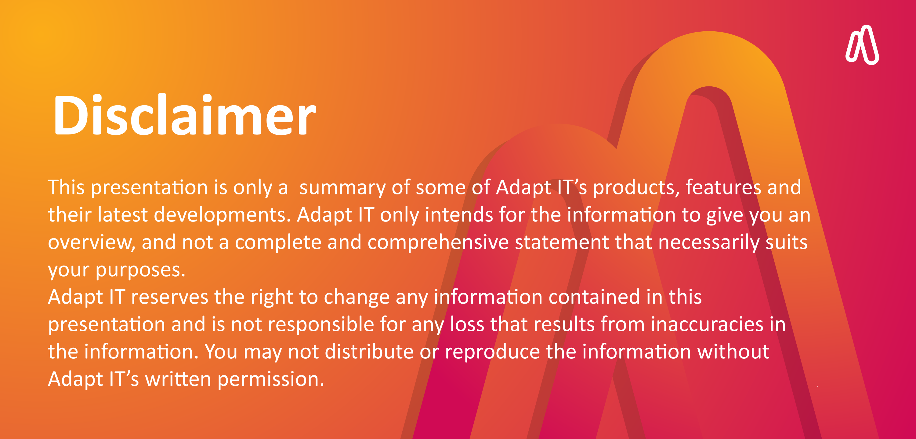
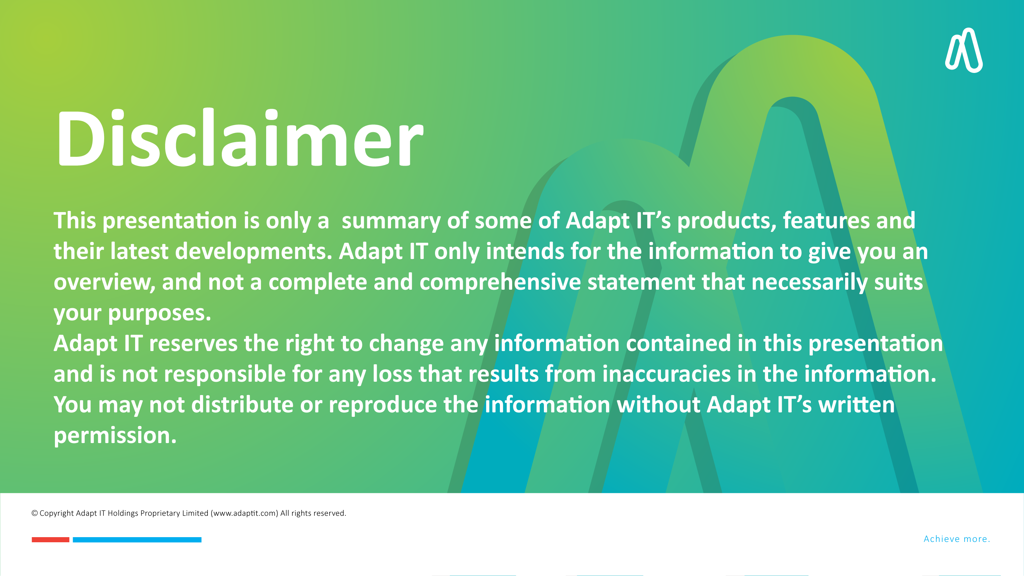
DISCLAIMER
This presentation is only a summary of some of Adapt IT’s products, features and their latest developments. Adapt IT only intends for the information to give you an overview, and not a complete and comprehensive statement that necessarily suits your purposes.
Adapt IT reserves the right to change any information contained in this presentation and is not responsible for any loss that results from inaccuracies in the information. You may not distribute or reproduce the information without Adapt IT’s written permission.

Slide 3
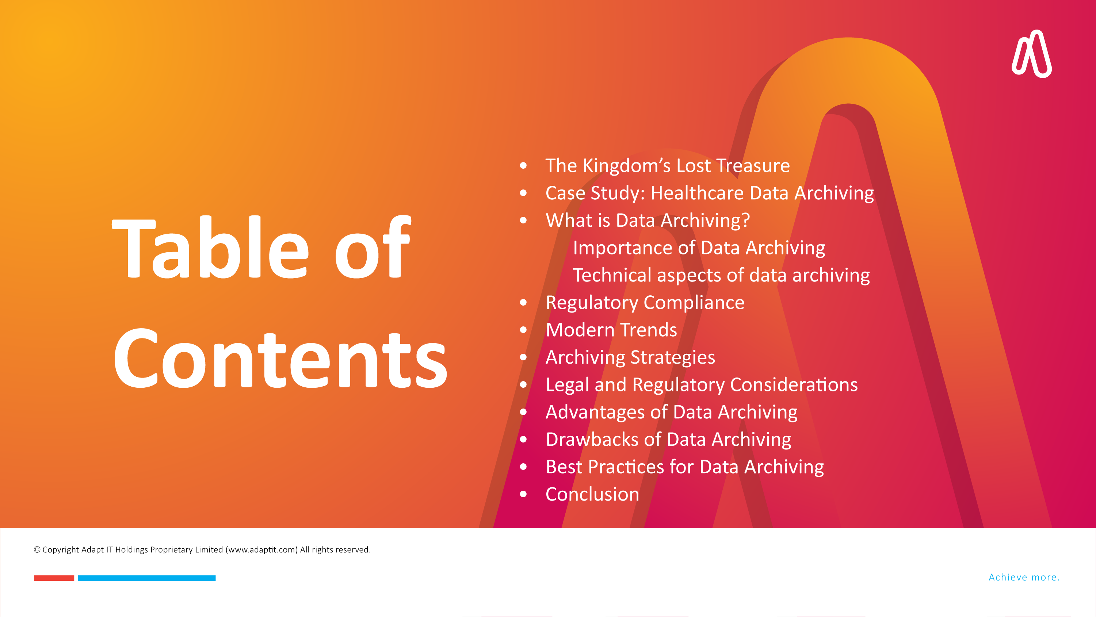
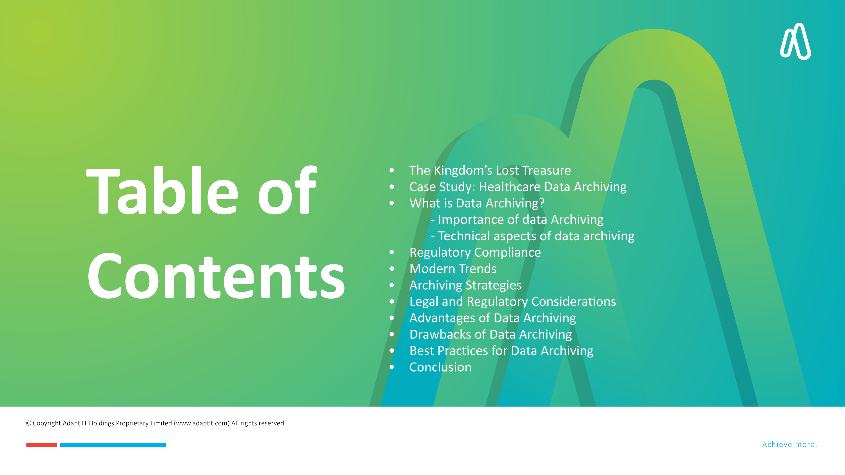
DISCLAIMER
This presentation is only a summary of some of Adapt IT’s products, features and their latest developments. Adapt IT only intends for the information to give you an overview, and not a complete and comprehensive statement that necessarily suits your purposes.
Adapt IT reserves the right to change any information contained in this presentation and is not responsible for any loss that results from inaccuracies in the information. You may not distribute or reproduce the information without Adapt IT’s written permission.

Slide 4



DISCLAIMER
This presentation is only a summary of some of Adapt IT’s products, features and their latest developments. Adapt IT only intends for the information to give you an overview, and not a complete and comprehensive statement that necessarily suits your purposes.
Adapt IT reserves the right to change any information contained in this presentation and is not responsible for any loss that results from inaccuracies in the information. You may not distribute or reproduce the information without Adapt IT’s written permission.

Slide 5
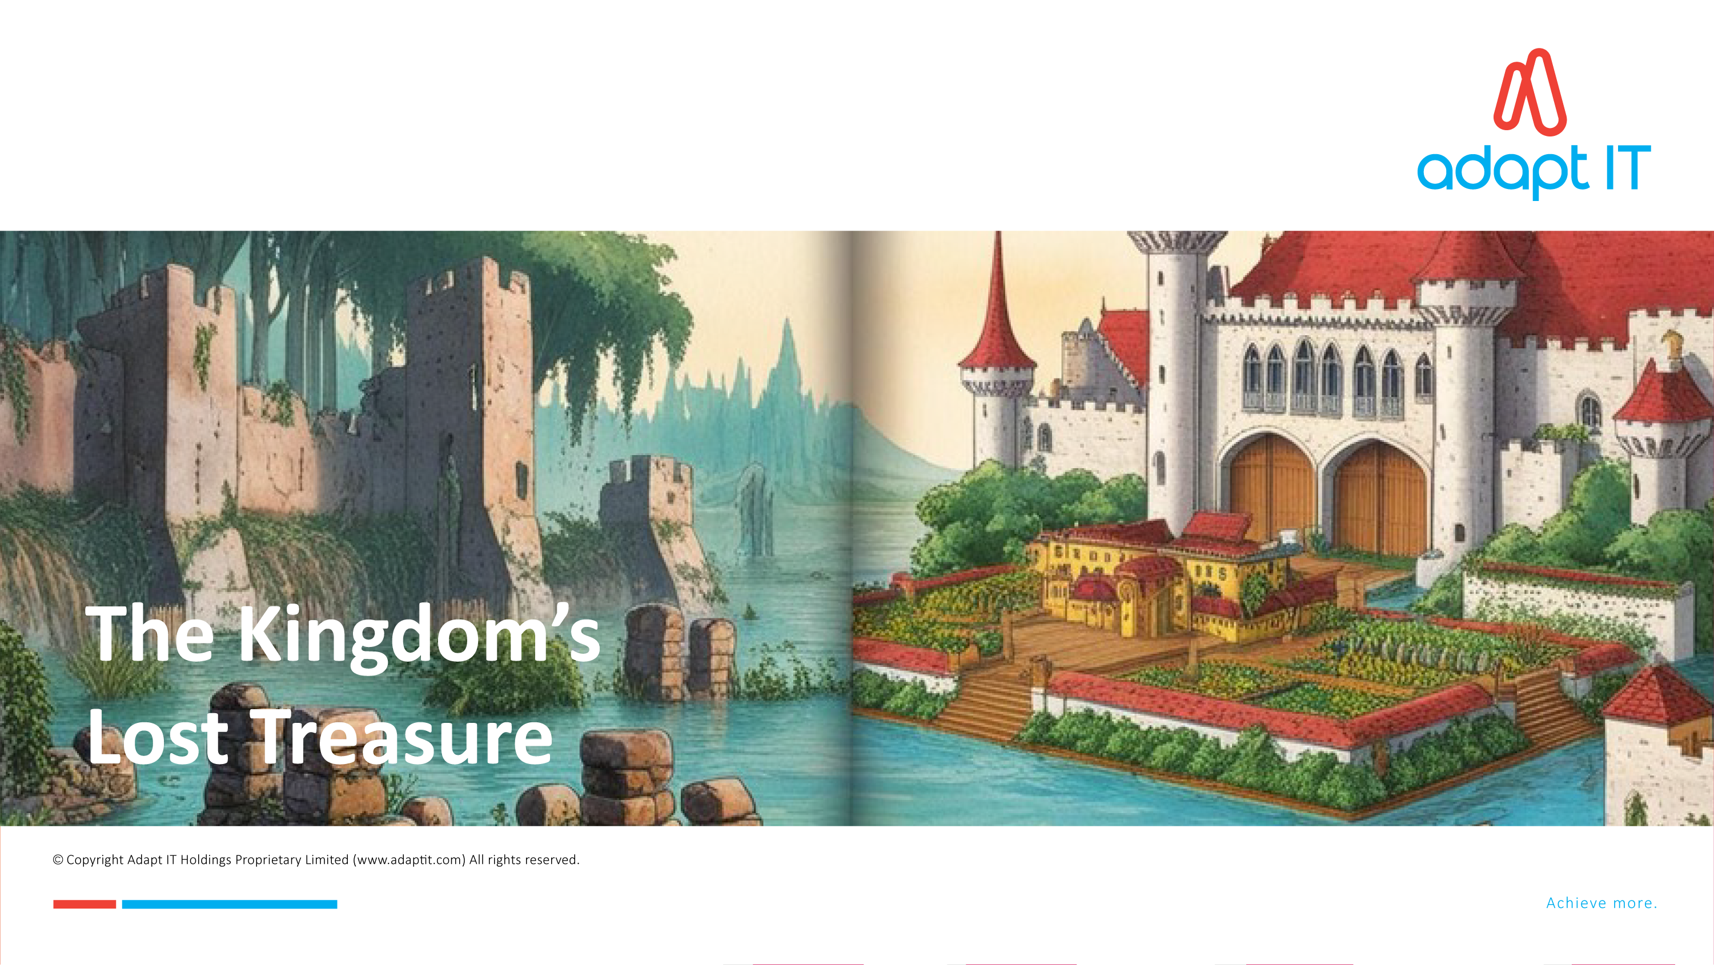

The Kingdom’s Lost Treasure
Notes:
The Kingdom’s Lost Treasure
In a distant kingdom, King Alaric ruled with wisdom and foresight. He believed in recording the kingdom’s history and preserving its knowledge, so he commissioned a grand library where all important documents, maps, and records would be archived. The task was entrusted to the royal archivist, a meticulous and patient man named Eldrin.
Eldrin created a system to catalog every document, ensuring each was labeled, stored in an orderly manner, and protected from damage. Over the years, the library grew to house records of treaties, trade agreements, agricultural knowledge, and even blueprints of the kingdom's defenses.
However, neighboring kingdoms mocked Alaric for spending so much on “dusty scrolls.” They believed the resources could be better spent on armies or extravagant celebrations.
Years later, a massive flood swept through the kingdom, destroying crops, homes, and infrastructure. The people were on the brink of despair, unsure of how to rebuild. But Eldrin remembered something: deep in the archives were ancient records of how the kingdom had survived a similar flood centuries earlier.
By accessing the archived documents, the people rediscovered methods of flood-resistant farming, plans for building water channels, and even strategies for managing displaced families. The knowledge allowed the kingdom to recover quickly and even thrive in the years that followed.
A neighboring king, seeing the kingdom’s swift recovery, visited Alaric and asked, “How did you manage to rebuild so quickly?” King Alaric replied, “While others build wealth that fades, we’ve built wisdom that lasts.”
Proper archiving preserves the knowledge and history that can guide us in times of need. It ensures that valuable lessons are not lost to time and equips us to face challenges with wisdom and preparedness.

Slide 6
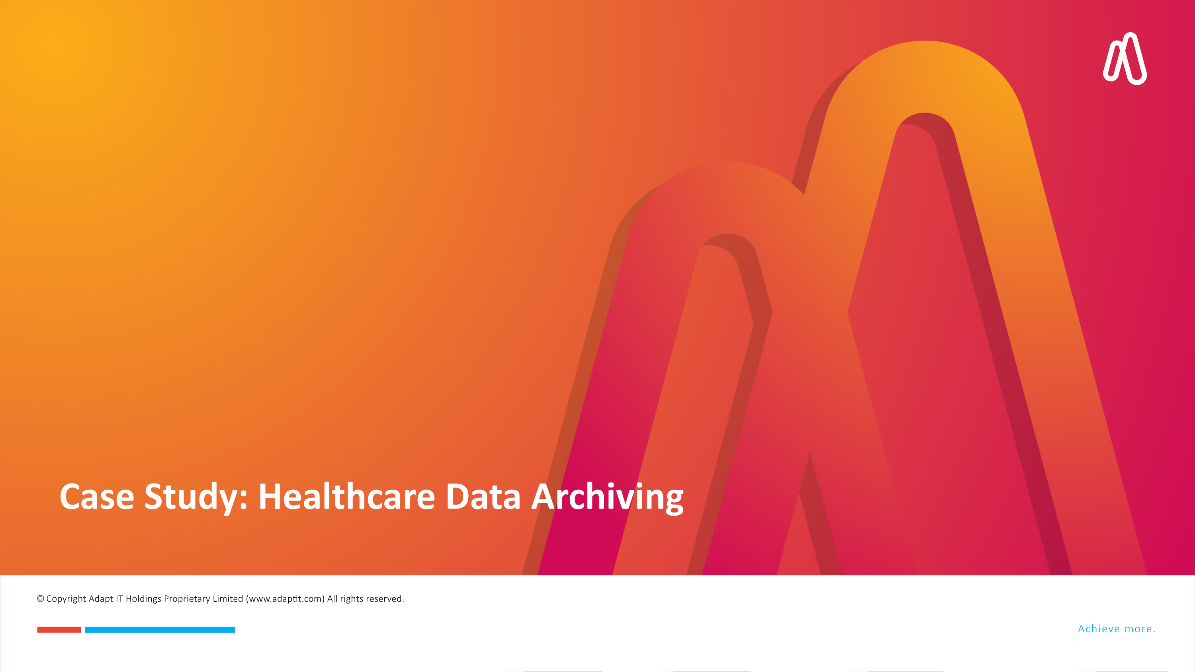
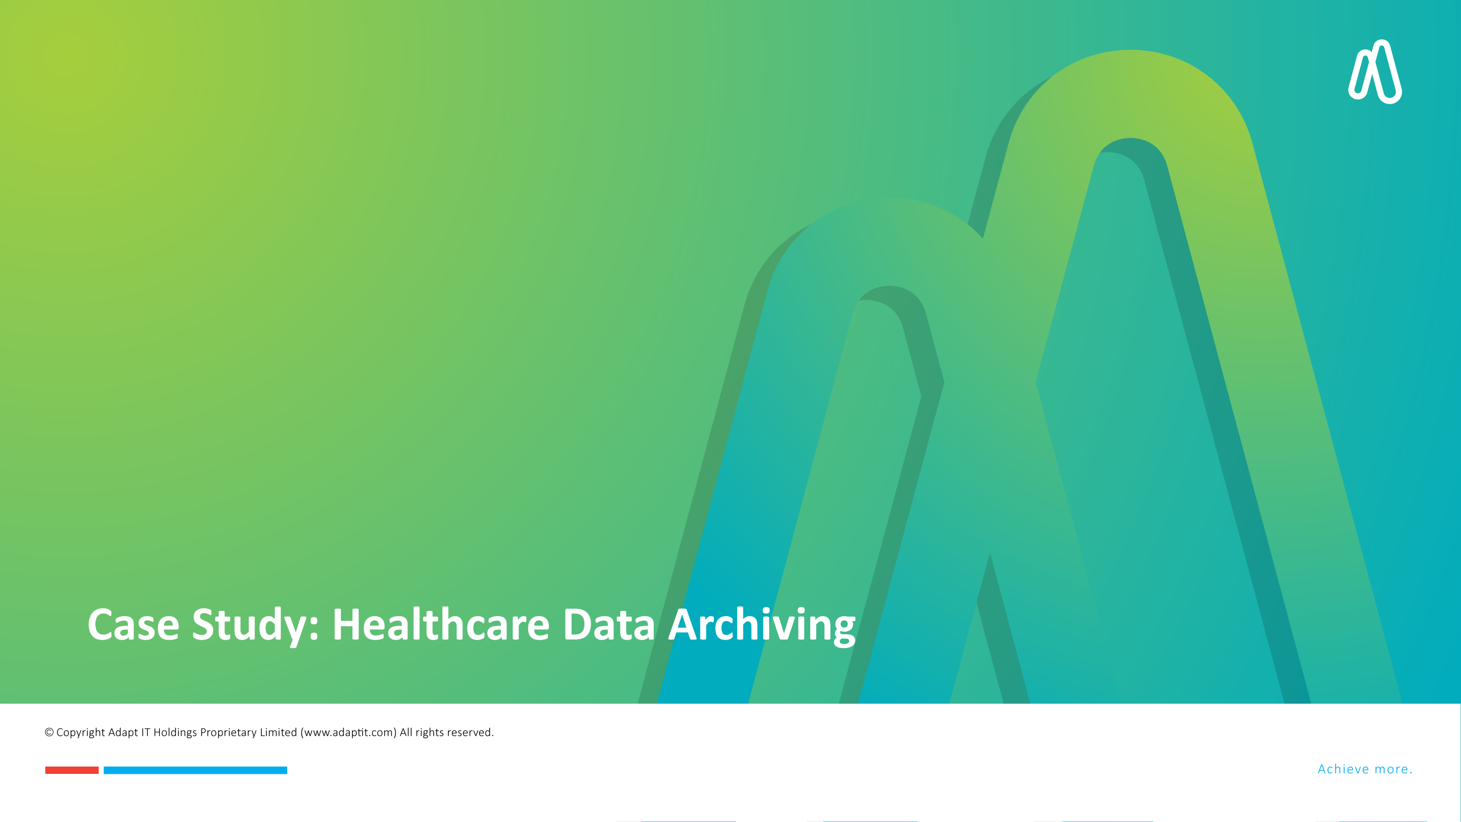
DISCLAIMER
This presentation is only a summary of some of Adapt IT’s products, features and their latest developments. Adapt IT only intends for the information to give you an overview, and not a complete and comprehensive statement that necessarily suits your purposes.
Adapt IT reserves the right to change any information contained in this presentation and is not responsible for any loss that results from inaccuracies in the information. You may not distribute or reproduce the information without Adapt IT’s written permission.

Slide 7



Case Study: Healthcare Data Archiving
Problem
  Accumulated decades of patient data
  Storage systems were overwhelmed
  Slow retrieval times
  Increased operational costs
Solution
  Moved inactive patient records long-term storage
  Freed up space systems
Impact
Improved system performance
Easy patient data accessible
Audits
Patient care
Reduction in storage costs
Improved compliance
Notes:
Case Study: Healthcare Data Archiving
A large hospital network faced significant challenges managing their patient records.
They had accumulated decades of patient data, and their storage systems were overwhelmed, leading to slow retrieval times and increased operational costs.
The hospital was also at risk of non-compliance with healthcare regulations like HIPAA, which mandates the retention of patient records for a specified period1.
To address these issues, the hospital implemented a robust data archiving strategy. They moved inactive patient records to a secure, long-term storage solution, freeing up space on their primary storage systems1.
This not only improved system performance but also ensured that patient data was easily accessible when needed for audits or patient care.
As a result, the hospital saw a significant reduction in storage costs and improved compliance with regulatory requirements.
The archiving strategy also enhanced data security, protecting patient information from potential breaches1.
This case study demonstrates how effective data archiving can lead to cost savings, improved compliance, and better data management, ultimately supporting the hospital's mission to provide high-quality patient care.
Does this story help illustrate the value of data archiving for your presentation?

Slide 8
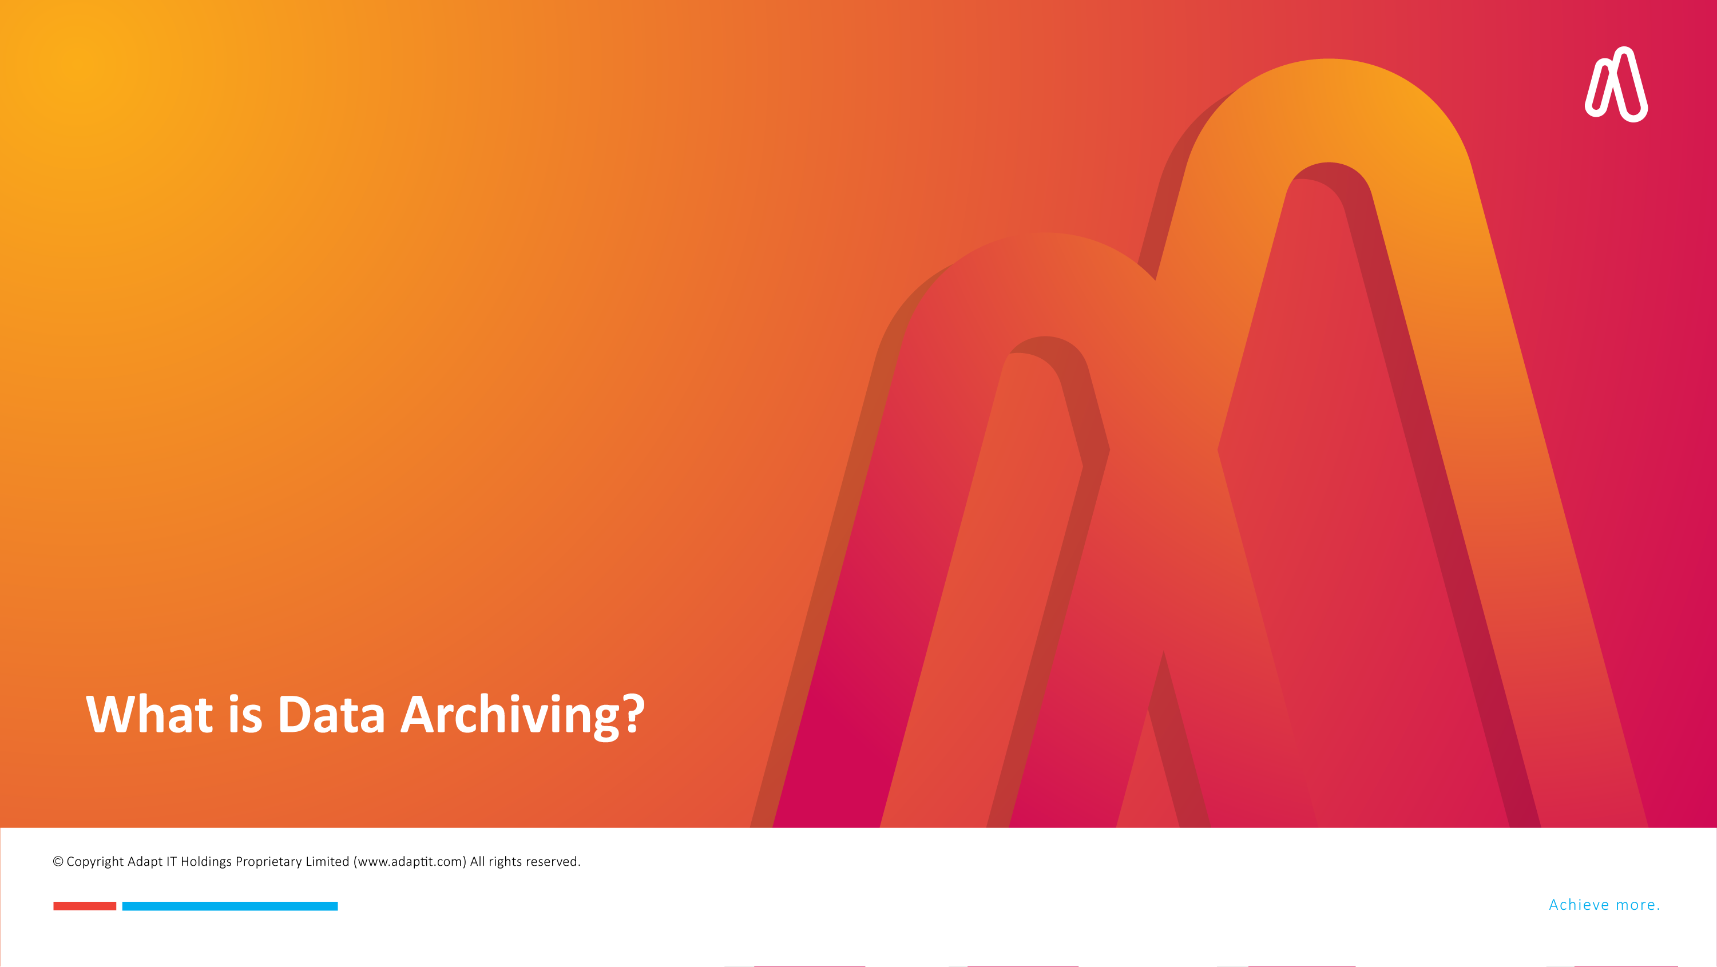
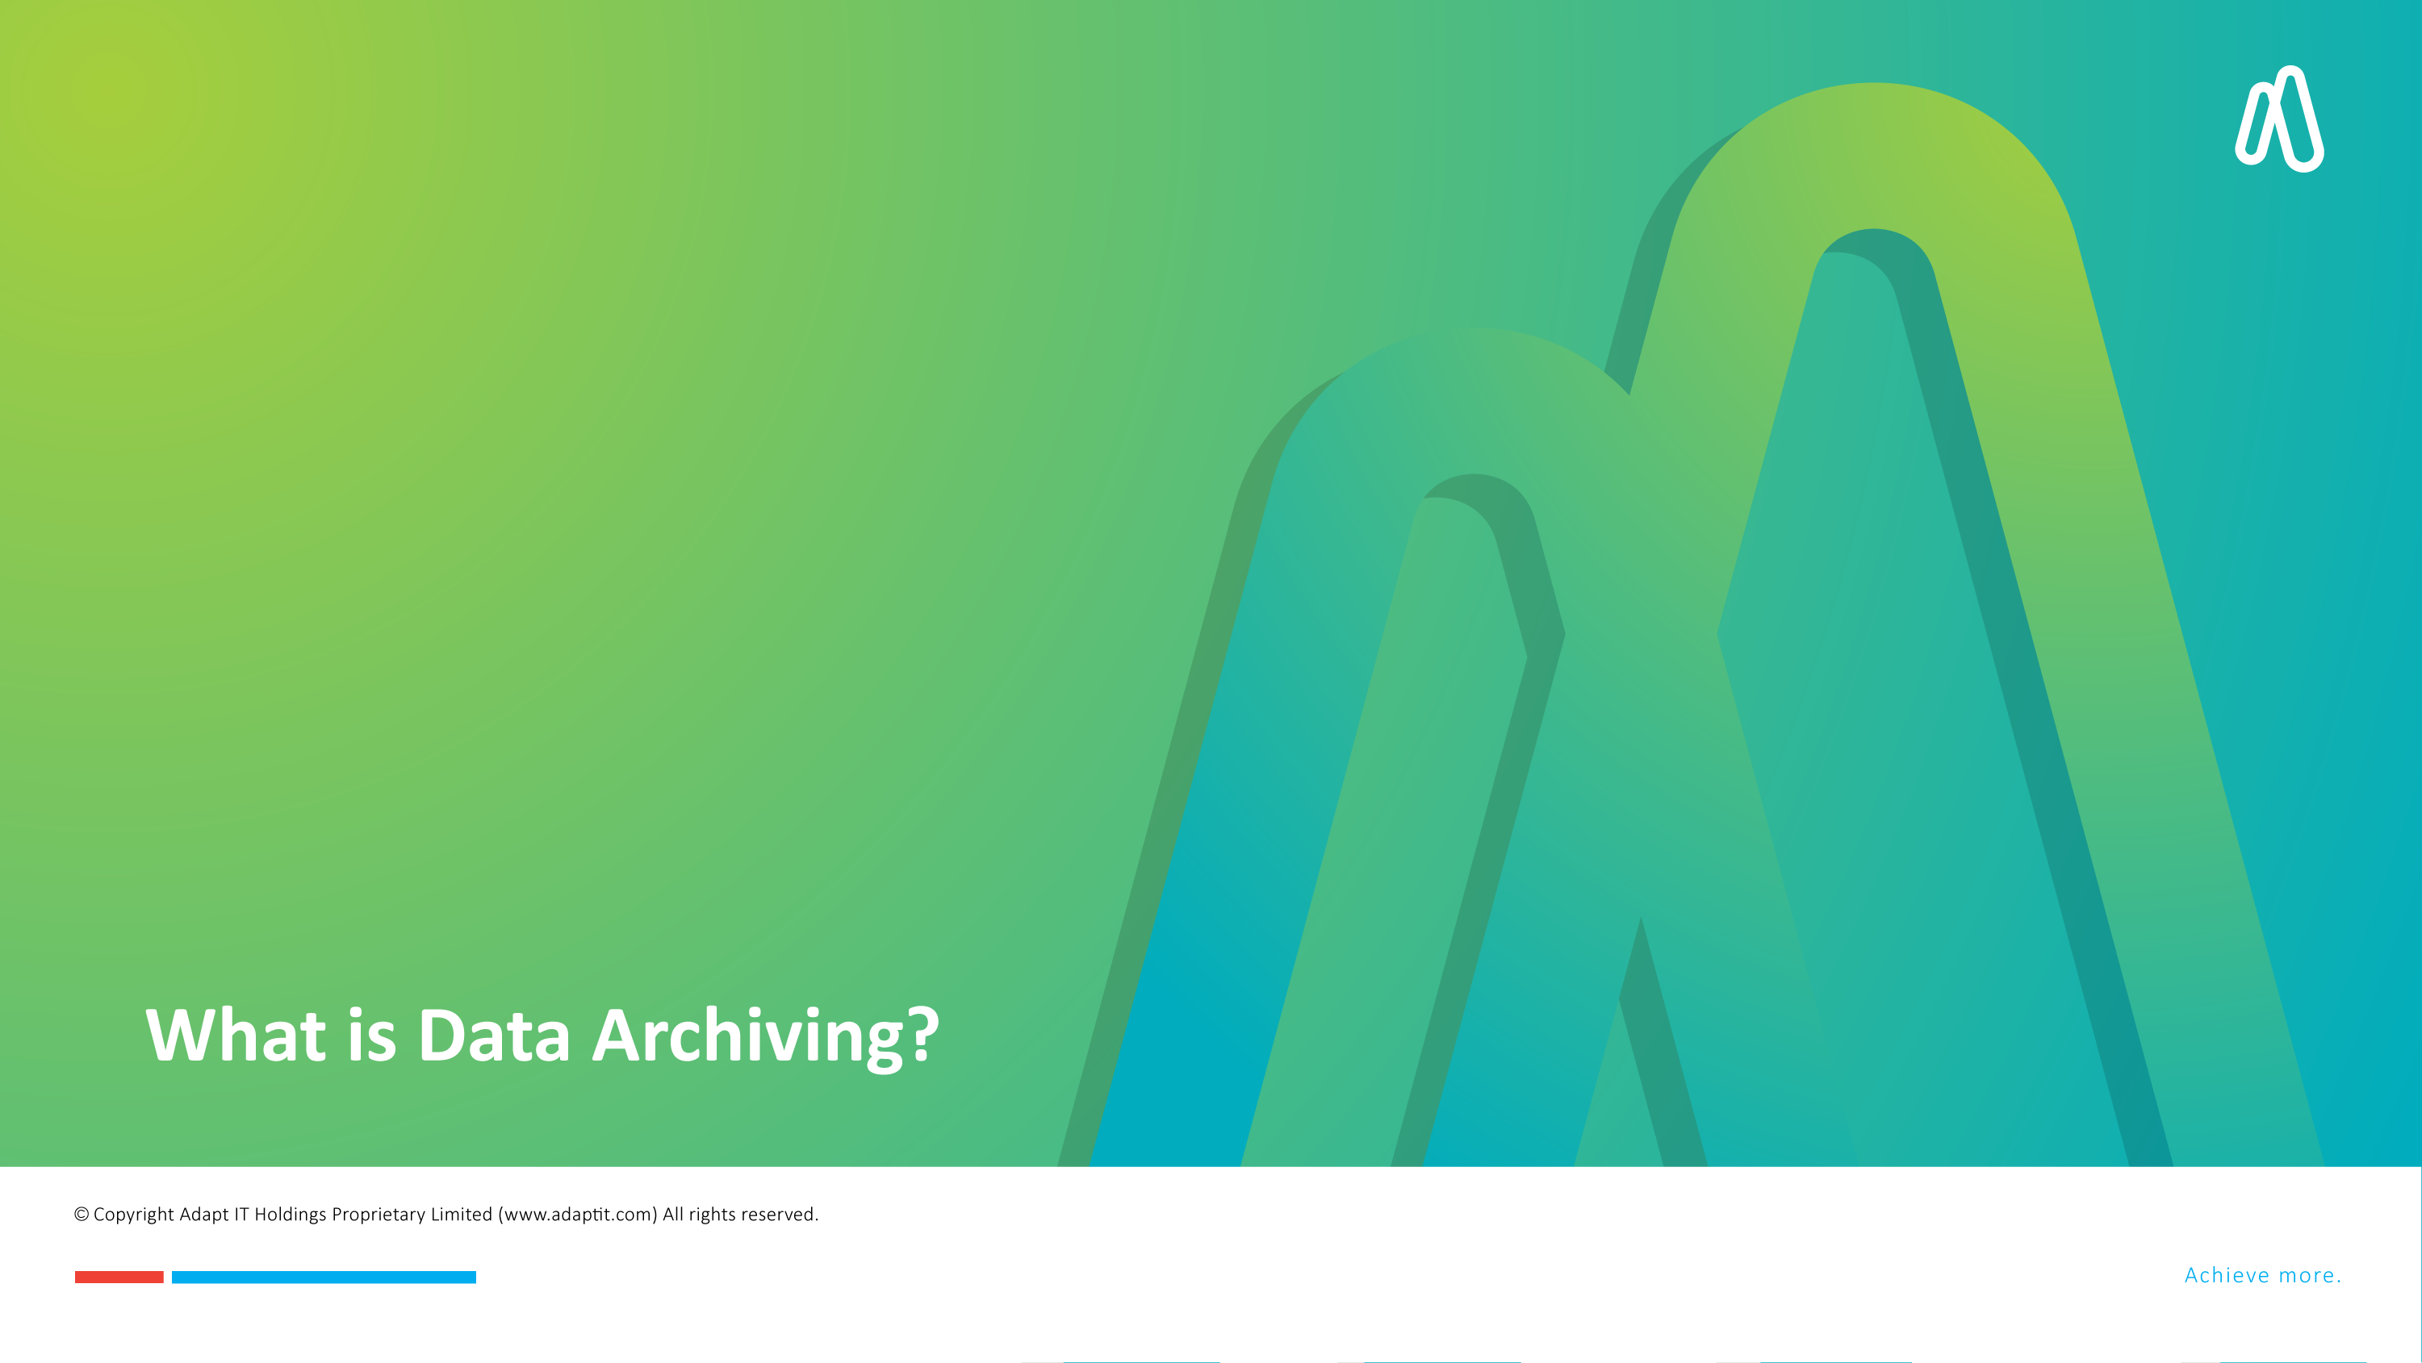
DISCLAIMER
This presentation is only a summary of some of Adapt IT’s products, features and their latest developments. Adapt IT only intends for the information to give you an overview, and not a complete and comprehensive statement that necessarily suits your purposes.
Adapt IT reserves the right to change any information contained in this presentation and is not responsible for any loss that results from inaccuracies in the information. You may not distribute or reproduce the information without Adapt IT’s written permission.

Slide 9

What is Data Archiving?
Long-term storage of data that is no longer actively used but must be retained for reference, compliance, or historical purposes.
Notes:
Reduce primary storage costs
Ensure data accessibility
Meet compliance requirements
Data archiving is the process of moving data that is no longer actively used to a separate storage device for long-term retention. Rather than keeping every annual report, obsolete database and old email thread taking up precious space on expensive primary storage, archiving lets you move that inactive stuff to cheaper, long-term storage built for retention.
The primary goal of data archiving is to save storage space, improve system performance, and maintain data safely over a long period. Below, we explore the various aspects of why data archiving is crucial for businesses across all sectors.

Slide 10



Importance of Data Archiving
Compliance
Performance Optimization
Cost Efficiency
Data Protection
Notes:
Cost Efficiency: Reduces costs by moving less-used data to cheaper storage.
Performance Optimization: Frees up space on primary storage for active data.
Compliance: Meets legal and regulatory retention mandates.
Data Protection: Preserves valuable historical and transactional data.
Cost savings
Compliance with regulations
Improved data management
Historical reference and analysis

Slide 11
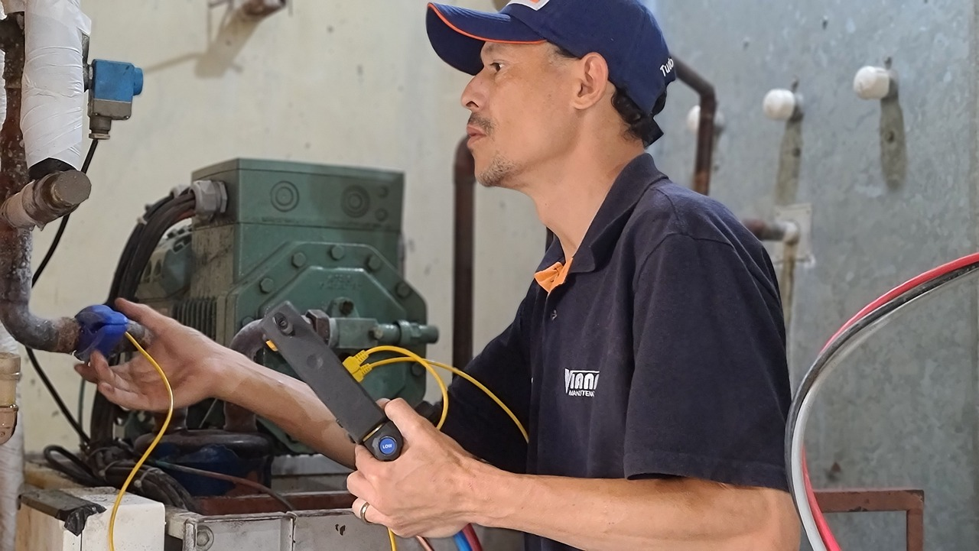
Technical aspects of data archiving
Data Classification & Lifecycle Management
Storage Infrastructure
Data Formats & Compression
Indexing & Searchability
Data Security & Encryption
Compliance & Legal Considerations
Backup & Disaster Recovery
Automation & Monitoring
Data Migration & Interoperability
Notes:
1. Data Classification & Lifecycle Management
Identifying active, inactive, and archival data.
Implementing policies for retention periods and deletion schedules.
Using metadata for quick retrieval.
2. Storage Infrastructure
On-premise storage (e.g., NAS, SAN, tape libraries).
Cloud storage (e.g., AWS Glacier, Azure Blob Storage, Google Cloud Archive).
Hybrid solutions combining both.
Cold vs. Hot storage: Cold storage for long-term archival, hot storage for quick access.
3. Data Formats & Compression
Using long-term readable formats (e.g., CSV, XML, PDF/A).
Applying compression algorithms (e.g., Gzip, LZMA, Zstd) to reduce storage space.
4. Indexing & Searchability
Maintaining an efficient index for rapid retrieval.
Using metadata tagging for better categorization.
Implementing search tools (e.g., Elasticsearch, Apache Solr).
5. Data Security & Encryption
Encryption at rest and in transit (AES-256, SSL/TLS).
Access control policies (role-based access, IAM policies).
Data masking for sensitive information.
6. Compliance & Legal Considerations
Meeting industry regulations (e.g., GDPR, HIPAA, SOX).
Ensuring audit trails and immutability.
Defining legal hold policies.
7. Backup & Disaster Recovery
Storing redundant copies in geographically separate locations.
Implementing checksum verification for integrity checks.
Planning data restoration procedures for recovery.
8. Automation & Monitoring
Using automated archiving solutions (e.g., Veeam, Commvault, AWS S3 Lifecycle Policies).
Setting up real-time monitoring with alerts for failures.
Conducting regular integrity tests.
9. Data Migration & Interoperability
Ensuring compatibility with future storage technologies.
Supporting data export/import with minimal effort.
Using standardized APIs for accessibility (e.g., REST, GraphQL).
Would you like insights on specific archiving tools or best practices?

Slide 12

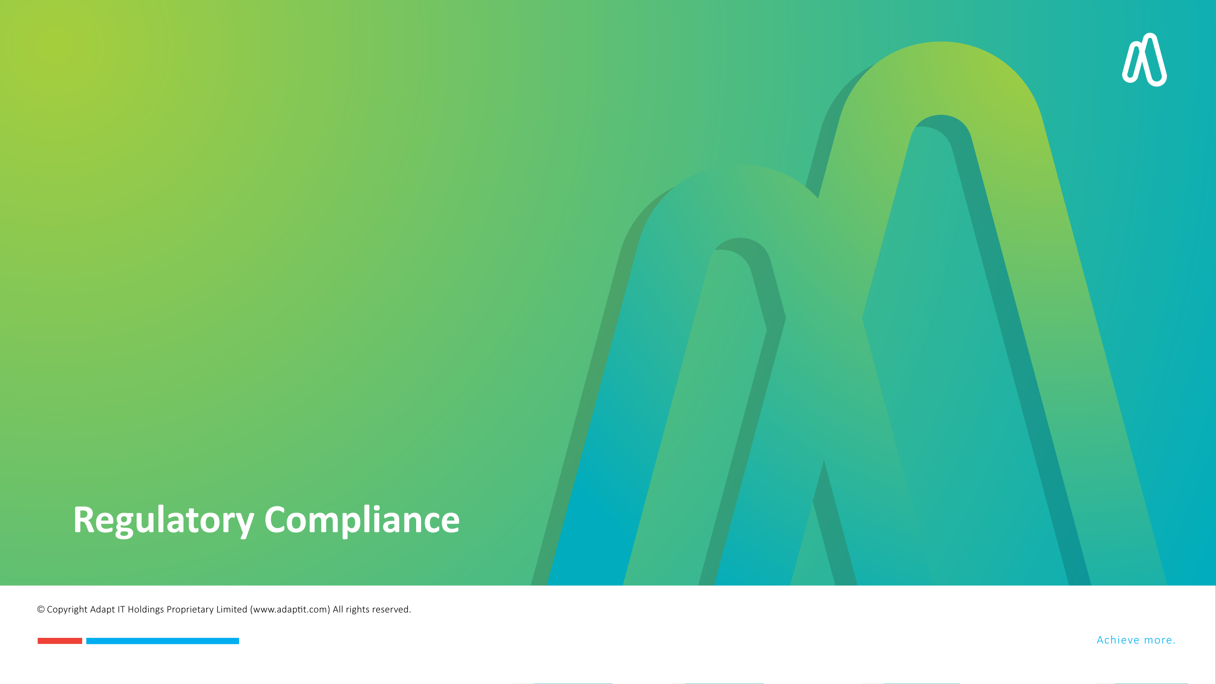
DISCLAIMER
This presentation is only a summary of some of Adapt IT’s products, features and their latest developments. Adapt IT only intends for the information to give you an overview, and not a complete and comprehensive statement that necessarily suits your purposes.
Adapt IT reserves the right to change any information contained in this presentation and is not responsible for any loss that results from inaccuracies in the information. You may not distribute or reproduce the information without Adapt IT’s written permission.

Slide 13

Regulatory Compliance
South Africa
Protection of Personal Information Act (POPIA)
Higher Education Act, No. 101 of 1997
National Qualifications Framework Act, No. 67 of 2008
National Archives Act (Act 43 of 1996)
Public Finance Management Act (PFMA) (Act 1 of 1999)
Higher Education Amendment Acts
Council on Higher Education (CHE) policies and guidelines
Institution-Specific Policies
Risk and Compliance Policies
Notes:
Namibia
National Archives Act (Act 23 of 1992)
Higher Education Act (Act 26 of 2003)
Public Finance Management Act (Act 1 of 1999)
Namibia Qualifications Authority Act (Act 29 of 1996)
Botswana
Data Protection Act (Act No. 28 of 2018)
Tertiary Education Council Act (Act No. 4 of 1999)
Public Finance Management Act (Act No. 14 of 2009)
Tertiary Education Council (TEC) policies and guidelines
Ghana
Data Protection Act, 2012 (Act 843)
National Archives Act, 1997 (Act 535)
Tertiary Education Act, 1992 (Act 451)
Public Financial Management Act, 2016 (Act 921)

Slide 14


DISCLAIMER
This presentation is only a summary of some of Adapt IT’s products, features and their latest developments. Adapt IT only intends for the information to give you an overview, and not a complete and comprehensive statement that necessarily suits your purposes.
Adapt IT reserves the right to change any information contained in this presentation and is not responsible for any loss that results from inaccuracies in the information. You may not distribute or reproduce the information without Adapt IT’s written permission.

Slide 15

Modern Trends
Cloud-Based Archiving
Artificial Intelligence
Automation
Cybersecurity
Data Privacy
Remote Work
Digital Transformation
Scalability
Notes:
Cloud-Based Archiving
Organizations are increasingly adopting cloud-based solutions for data archiving due to cost savings, enhanced accessibility, and improved disaster recovery capabilities. Cloud storage allows for scalable and flexible data management, making it easier to handle large volumes of data1.
2. Artificial Intelligence (AI) and Machine Learning (ML)
AI and ML are revolutionizing data archiving by automating processes, improving search capabilities, and ensuring data integrity. AI-driven archiving uses advanced algorithms to streamline file management and retrieval, making it faster and more accurate1.
3. Automation
Automation is transforming records management by reducing manual tasks and improving efficiency. Automated workflows help in categorizing, indexing, and archiving data, ensuring compliance with regulatory requirements and reducing human error3.
4. Cybersecurity
With the increasing threat of cyberattacks, data security has become a top priority. Modern archiving solutions incorporate advanced encryption, access controls, and monitoring to protect sensitive information from unauthorized access and breaches3.
5. Data Privacy
Compliance with data privacy regulations such as GDPR and CCPA is crucial. Organizations are implementing robust data privacy measures to ensure that archived data is handled in accordance with legal requirements and best practices4.
6. Remote Work
The rise of remote work has led to a greater need for secure and accessible data archiving solutions. Cloud-based archiving and remote access capabilities enable employees to work from anywhere while maintaining data security and compliance1.
7. Digital Transformation
Digital transformation is driving the adoption of modern records management practices. Organizations are moving away from traditional paper-based systems to digital solutions that offer better data management, accessibility, and compliance2.
8. Scalability
As data volumes continue to grow, scalability has become a critical factor in data archiving. Modern solutions are designed to handle large amounts of data efficiently, ensuring that organizations can scale their archiving capabilities as needed4.
These trends highlight the ongoing evolution of data archiving and records management, driven by the need for efficiency, security, and compliance in an increasingly digital world.
Is there a specific trend you'd like to explore further?

Slide 16
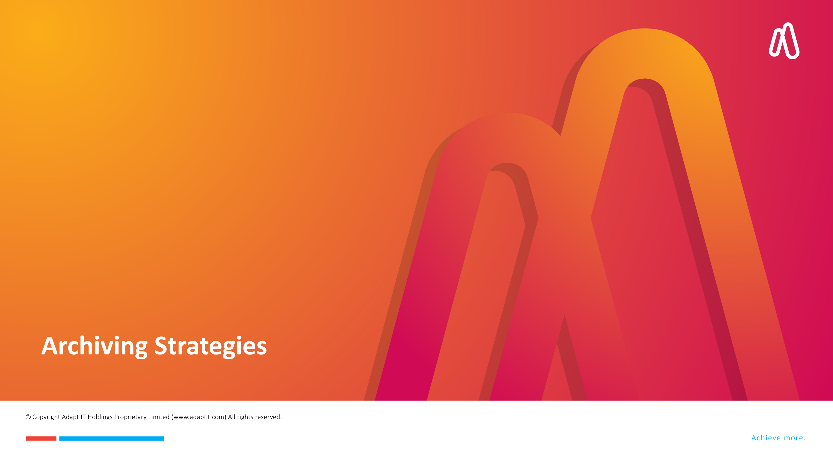
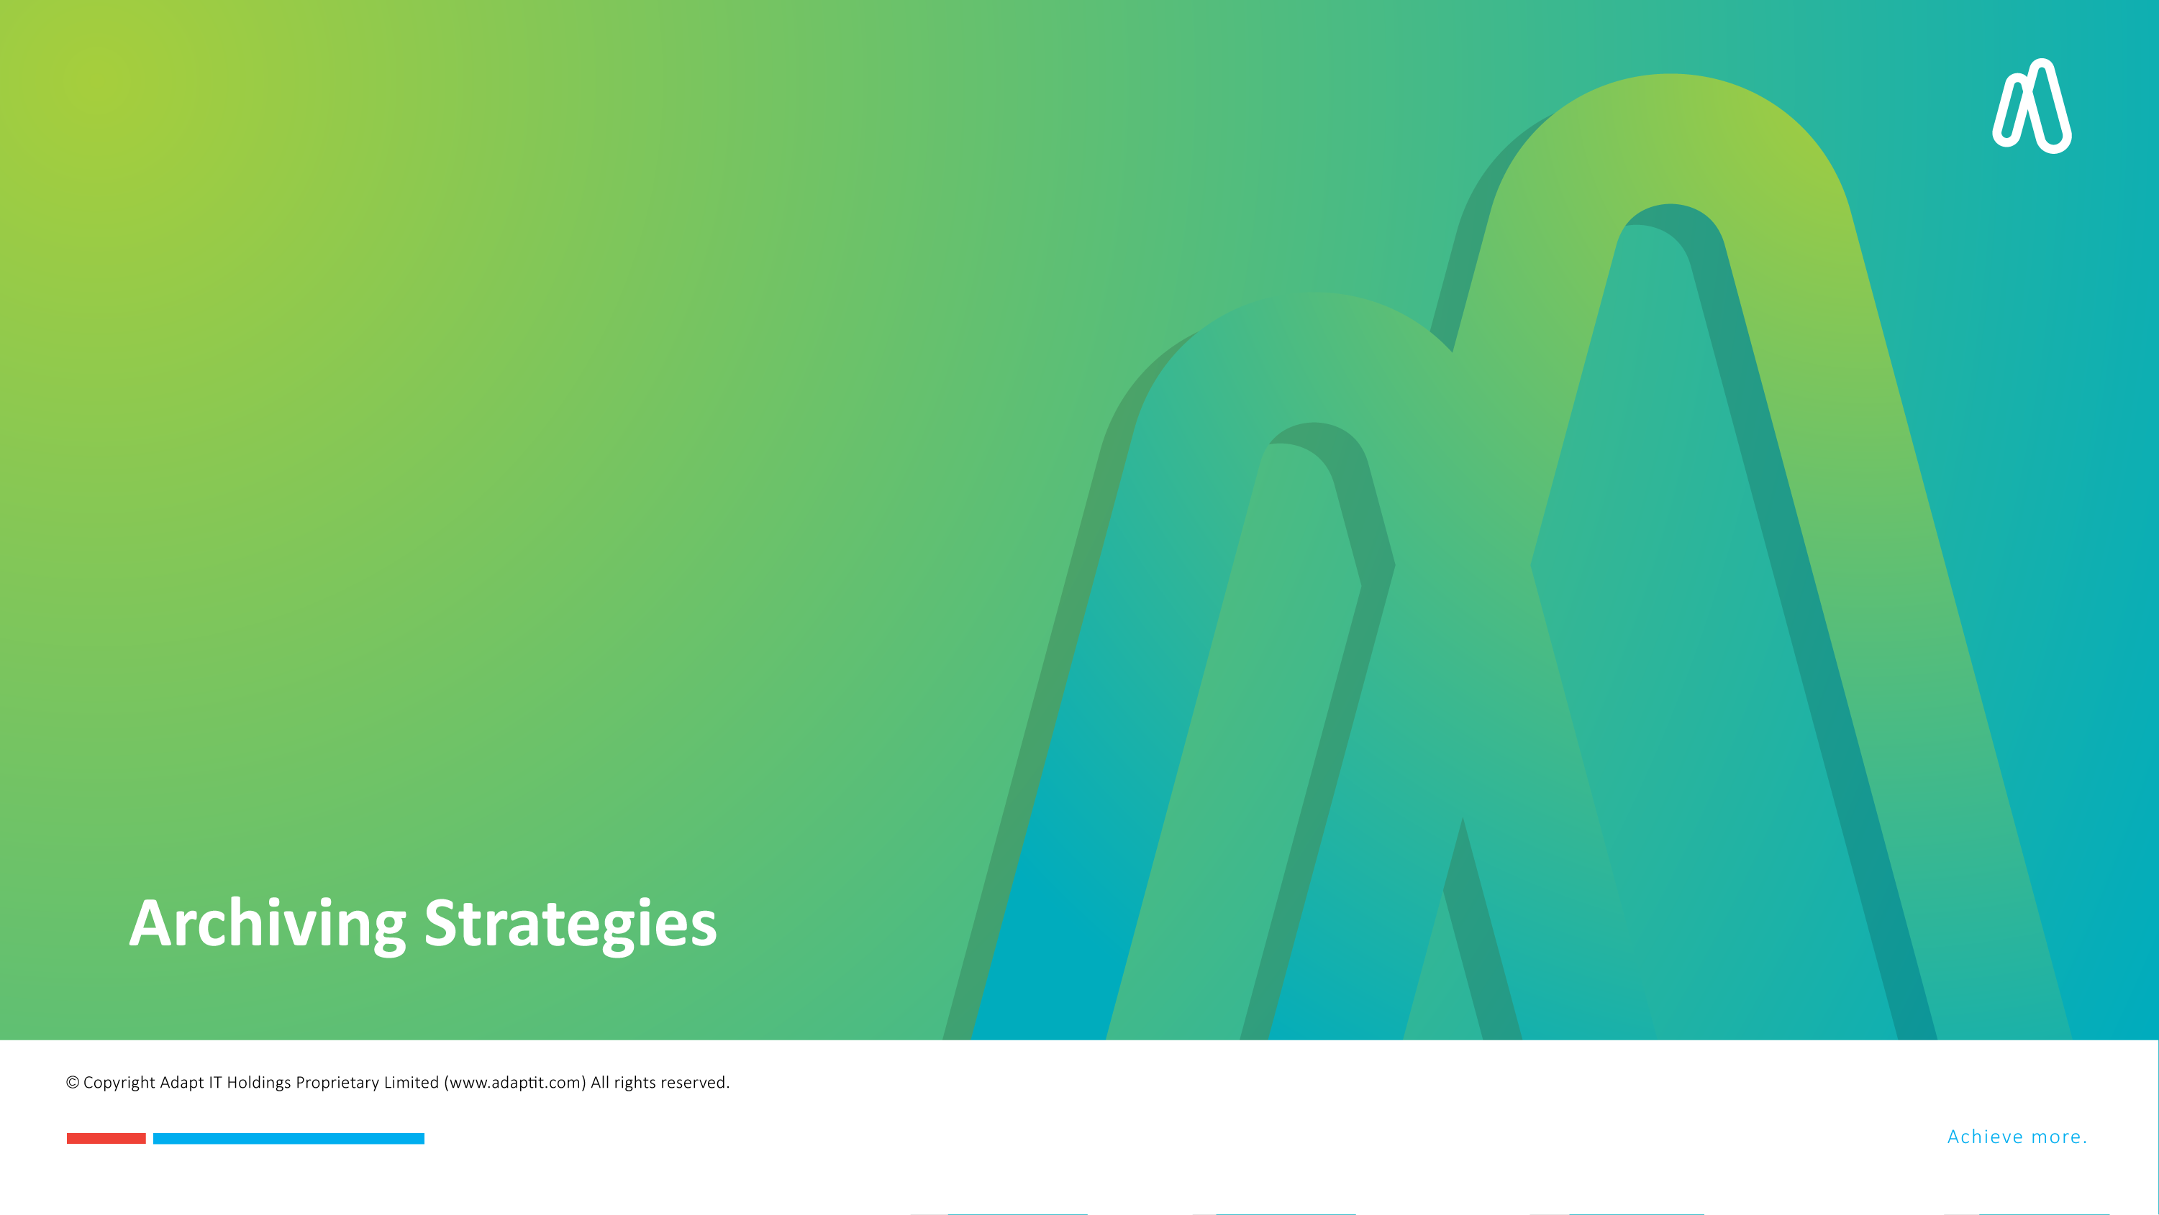
DISCLAIMER
This presentation is only a summary of some of Adapt IT’s products, features and their latest developments. Adapt IT only intends for the information to give you an overview, and not a complete and comprehensive statement that necessarily suits your purposes.
Adapt IT reserves the right to change any information contained in this presentation and is not responsible for any loss that results from inaccuracies in the information. You may not distribute or reproduce the information without Adapt IT’s written permission.

Slide 17

Archiving Strategies
Offline Archiving
Nearline Archiving
Cloud Archiving
Hybrid Archiving
Integrated Archiving Systems
Notes:
Offline Archiving:
Data stored on tapes, external drives, or removable media.
Suitable for long-term storage with infrequent access.
Nearline Archiving:
Data stored on slower disks or cloud tiers.
Balances cost and accessibility.
Cloud Archiving:
Leverages cloud providers for scalable and remote storage.
Offers flexible access and disaster recovery options.
Hybrid Archiving:
Combines on-premises and cloud solutions for tailored needs.
Integrated Archiving Systems:
Tools like data lakes or enterprise content management (ECM) systems.
Identify and Sort Data: Inventory and categorize data before archiving
Synchronize with Data Lifecycle Management: Align archiving with data lifecycle policies
Plan for Regulatory Compliance: Ensure compliance with relevant regulations
Select the Right Archiving Tool: Choose tools that meet your needs
Develop a Data Archiving Policy: Create a formal policy for archiving procedures
Data Volume and Growth: Managing large amounts of data
Data Classification and Identification: Deciding which data to archive
Compliance Requirements: Meeting industry-specific regulations
Data Integrity: Ensuring data remains intact and accessible

Slide 18
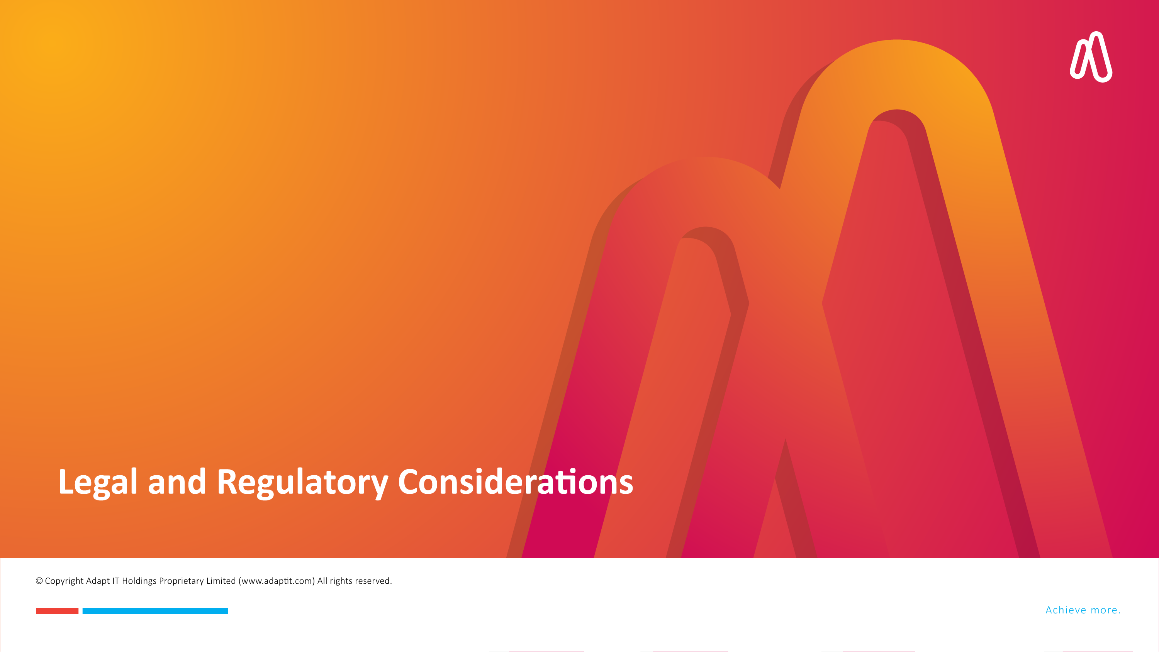
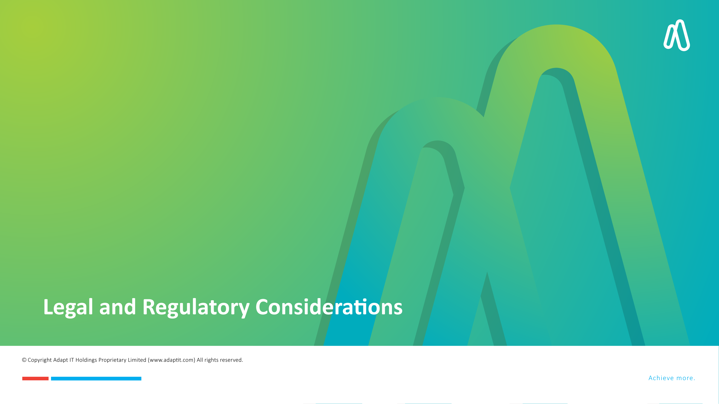
DISCLAIMER
This presentation is only a summary of some of Adapt IT’s products, features and their latest developments. Adapt IT only intends for the information to give you an overview, and not a complete and comprehensive statement that necessarily suits your purposes.
Adapt IT reserves the right to change any information contained in this presentation and is not responsible for any loss that results from inaccuracies in the information. You may not distribute or reproduce the information without Adapt IT’s written permission.

Slide 19
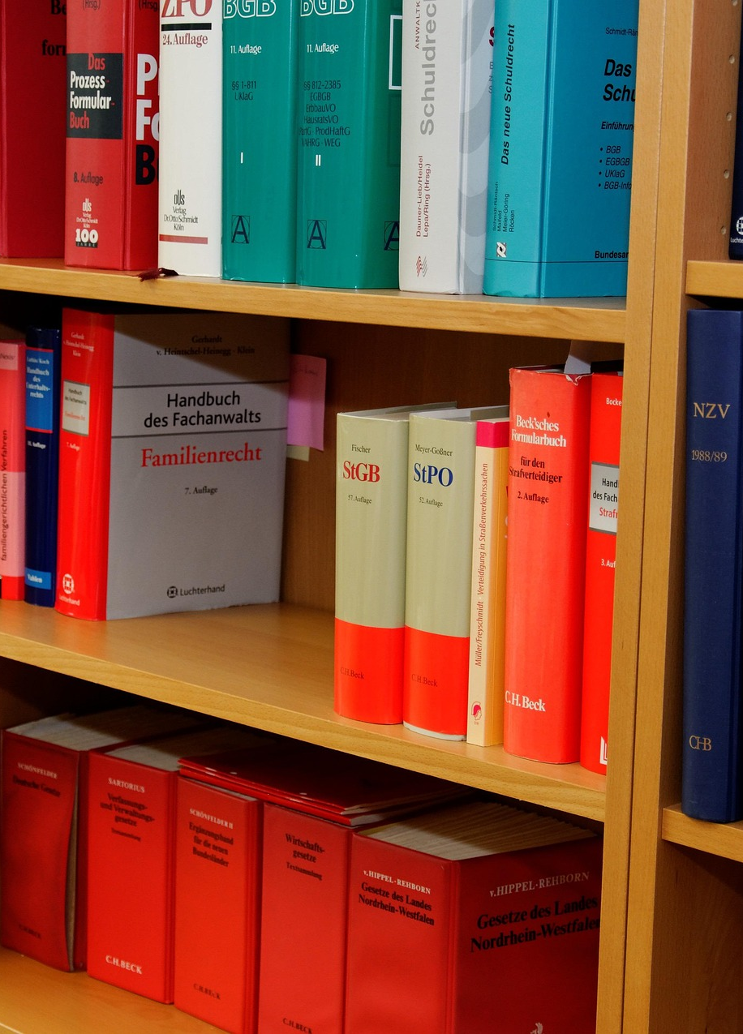
Legal and Regulatory Considerations
Retention Requirements
Data Privacy Laws
Audit Trails
Disposal Policies
Notes:
Retention Requirements:
Vary by industry (e.g., GDPR, HIPAA, SOX).
Specify how long data must be retained.
Data Privacy Laws: Ensure compliance with regulations on sensitive data.
Audit Trails: Maintain records of access and modifications.
Disposal Policies: Define how data should be securely deleted after retention periods.
Data Protection Laws: Overview of relevant laws (e.g., GDPR, HIPAA)
Retention Policies: Industry-specific retention requirements
Audit and Compliance: Ensuring data archives meet regulatory standards

Slide 20
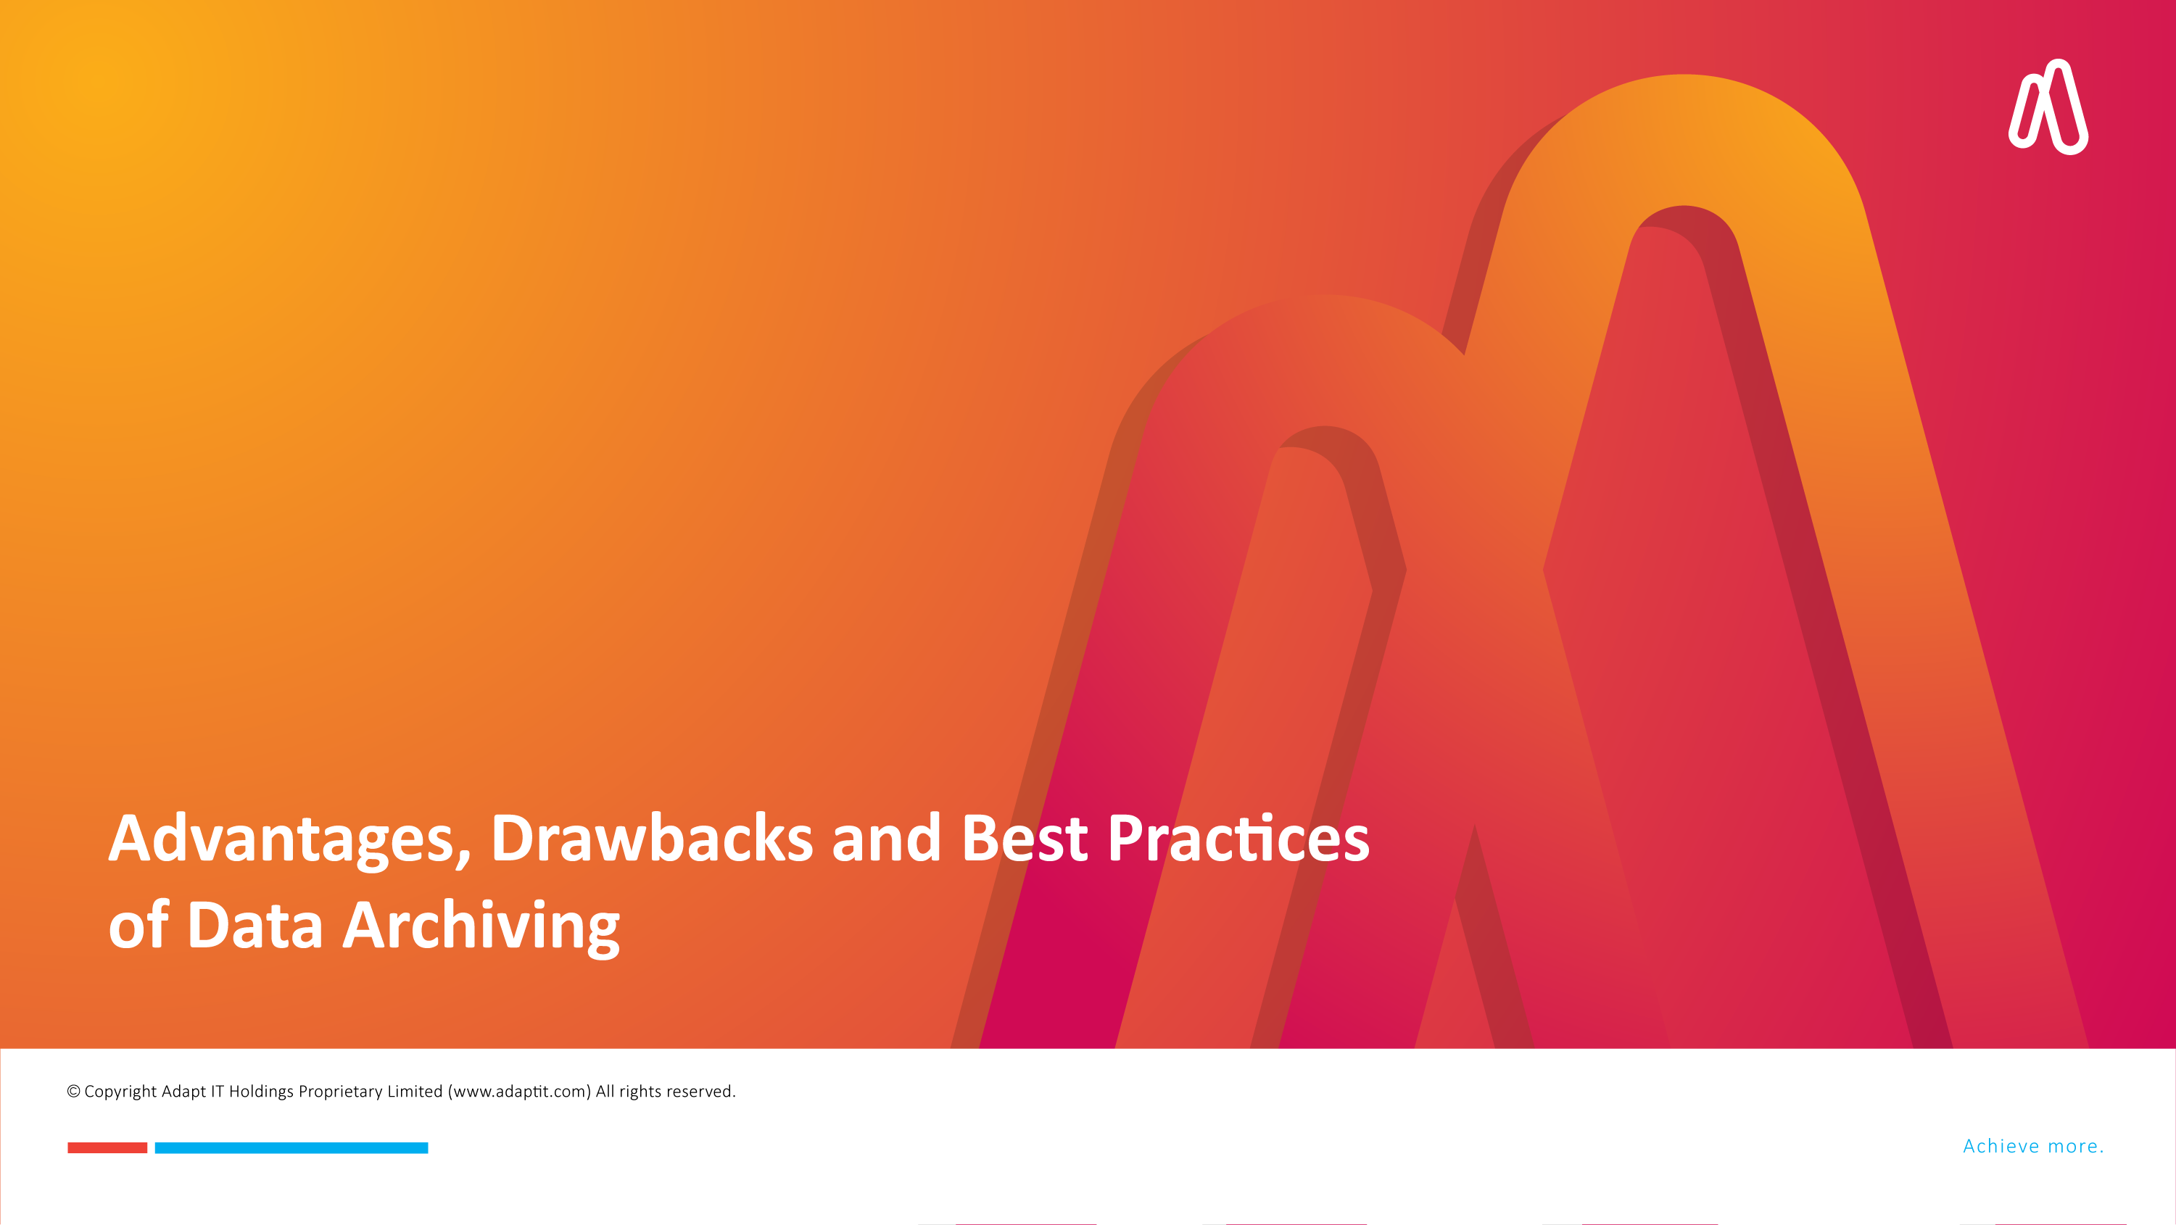
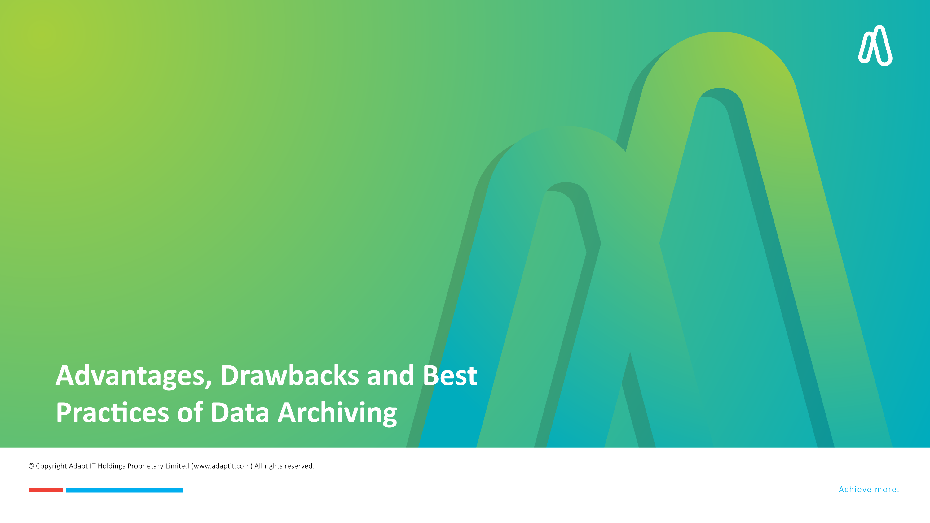
DISCLAIMER
This presentation is only a summary of some of Adapt IT’s products, features and their latest developments. Adapt IT only intends for the information to give you an overview, and not a complete and comprehensive statement that necessarily suits your purposes.
Adapt IT reserves the right to change any information contained in this presentation and is not responsible for any loss that results from inaccuracies in the information. You may not distribute or reproduce the information without Adapt IT’s written permission.

Slide 21

Advantages of Data Archiving
Cost Savings
Improved Efficiency
Regulatory Compliance
Data Preservation
Business Insights
Notes:
Cost Savings:
Reduces the need for expensive primary storage.
Improved Efficiency:
Speeds up active systems by offloading dormant data.
Regulatory Compliance:
Ensures adherence to legal and industry standards.
Data Preservation:
Protects historical records for future use.
Business Insights:
Enables data analysis on archived information
Increased Storage Capacity: Freeing up space for new data
Easier and Faster Backup: Simplified backup processes
Increased Security: Reducing the risk of data breaches
Reduced Costs: Lower maintenance and operation costs

Slide 22

Drawbacks of Data Archiving
Cost of Implementation
Access Delays
Risk of Data Loss
Security Concerns
Regulatory Risks
Notes:
Reduce primary storage costs
Ensure data accessibility
Meet compliance requirements
Data archiving is the process of moving data that is no longer actively used to a separate storage device for long-term retention. Rather than keeping every annual report, obsolete database and old email thread taking up precious space on expensive primary storage, archiving lets you move that inactive stuff to cheaper, long-term storage built for retention.
The primary goal of data archiving is to save storage space, improve system performance, and maintain data safely over a long period. Below, we explore the various aspects of why data archiving is crucial for businesses across all sectors.

Slide 23

Best Practices for Data Archiving
Define Clear Policies
Automate Where Possible
Regularly Review Archives
Encrypt Data
Monitor and Audit
Train Staff
Notes:
Define Clear Policies:
Specify retention periods and archiving criteria.
Automate Where Possible:
Use tools to automate archiving workflows.
Regularly Review Archives:
Ensure relevance and compliance of archived data.
Encrypt Data:
Protect archived data with robust encryption.
Monitor and Audit:
Track access and modifications to archived data.
Train Staff:
Educate employees on proper archiving protocols.

Slide 24


DISCLAIMER
This presentation is only a summary of some of Adapt IT’s products, features and their latest developments. Adapt IT only intends for the information to give you an overview, and not a complete and comprehensive statement that necessarily suits your purposes.
Adapt IT reserves the right to change any information contained in this presentation and is not responsible for any loss that results from inaccuracies in the information. You may not distribute or reproduce the information without Adapt IT’s written permission.
Notes:
Key Takeaways:
Data archiving is crucial for cost efficiency, compliance, and data preservation.
Success depends on selecting the right strategy, addressing technical and regulatory challenges, and adhering to best practices.
Call to Action: Start evaluating your organization’s data archiving needs and implement a robust strategy today.

Slide 25

Questions
Questions ?

